Slide 1

Intracranial pulsatility and cerebral white matter hyperintensity burden in a community-dwelling elderly population
Markus Kneihsl
Department of Neurology; Medical University of Graz; Austria
e-mail: markus.kneihsl@medunigraz.at

Slide 2
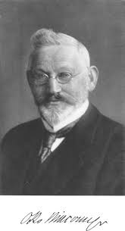
Cerebral small vessel disease (SVD)
SVD is responsible for about 20% of all strokes and 45% of dementia worldwide
vascular dementia caused by atherosclerotic damage of the white brain matter (Binswanger’s disease)
MRI gold standard for in vivo diagnosis
Wardlaw et al. Lancet Neurol 2013
Gorelick et al. Stroke 2011
Notes:
Otto Ludwig Binswanger

Slide 3
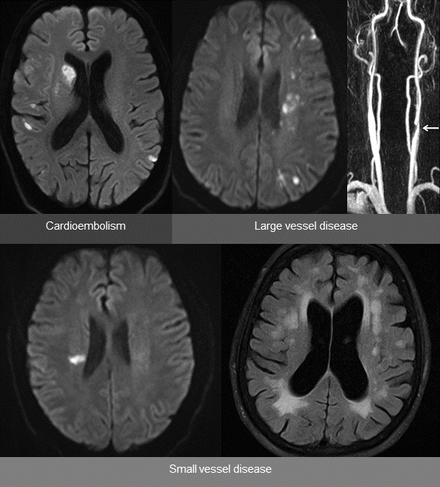
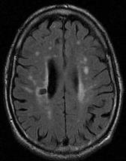
Features of cerebral small vessel disease (1)
Recent small subcortical infarct
Lacunes
Notes:
Basal ganglia, thalamus…evolve

Slide 4
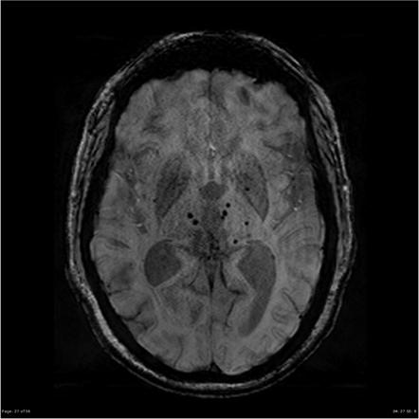
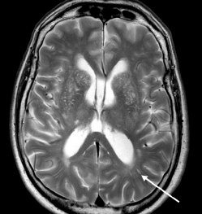
Features of cerebral small vessel disease (2)
Microbleeds
Enlarged perivascular spaces
Notes:
Basal ganglia, thalamus…evolve

Slide 5
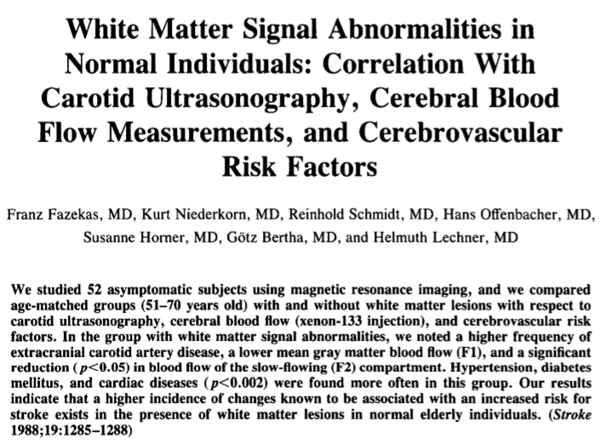
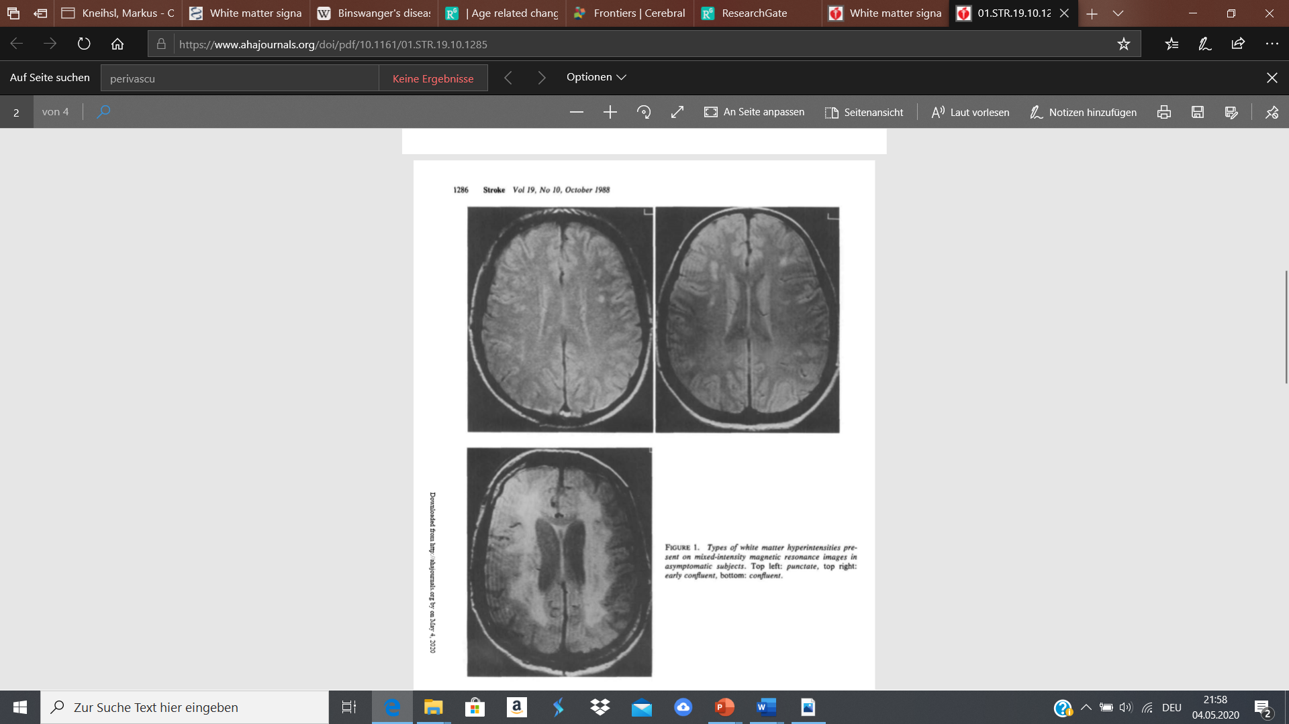
Cerebral white matter hyperintensities (WMH)
WMH - Fazekas III
Notes:
Most widely applicable scale

Slide 6
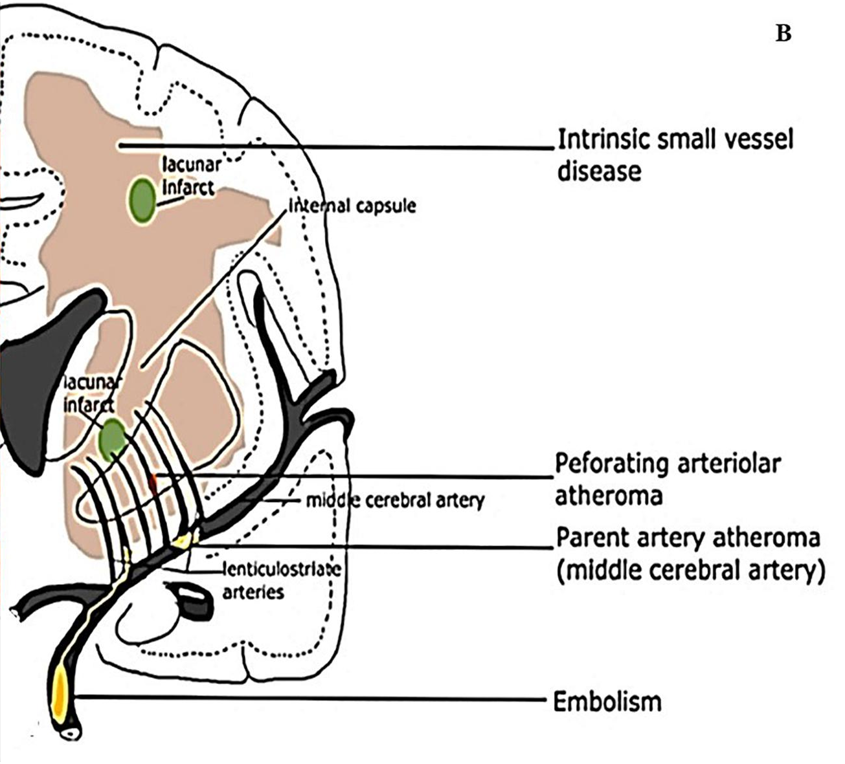
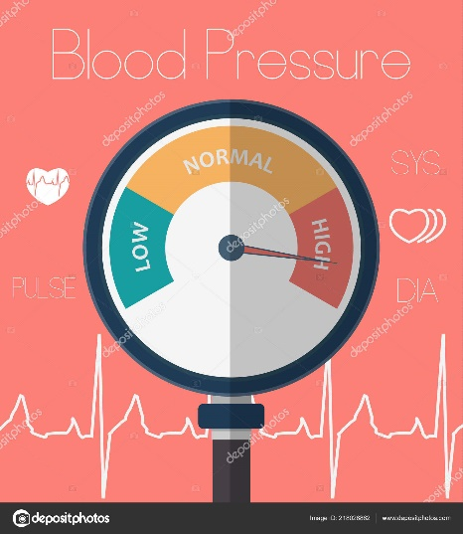
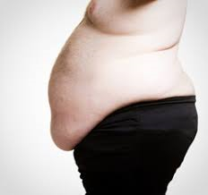
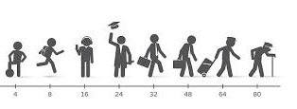
Pathophysiology
Lipohyalinosis / arteriolosclerosis
  -dilatation and thickening of arteriolar walls
Microatheroma
  -affects more proximal artery segments
AGING
Mustapha et al. Front Physiol 2019
Notes:
Obesity

Slide 7
Pathophysiology
AGE
Hypertension
WMH
Arterial stiffening / vessel damage
Van Varik et al. Front Genet 2012

Slide 8
Pulse wave and arterial stiffening
Van Varik et al. Front Genet 2012

Slide 9
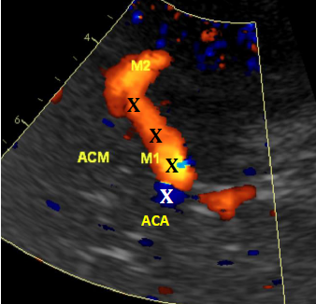
Ultrasound – Transcranial Doppler / Duplex Sonography (TCD)
Middle cerebral artery (MCA)

Slide 10
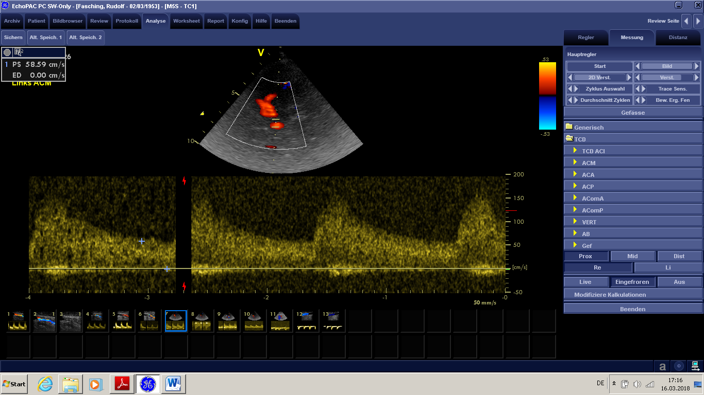
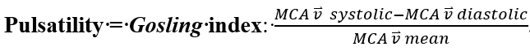
TCD pulsatility index - MCA

Slide 11
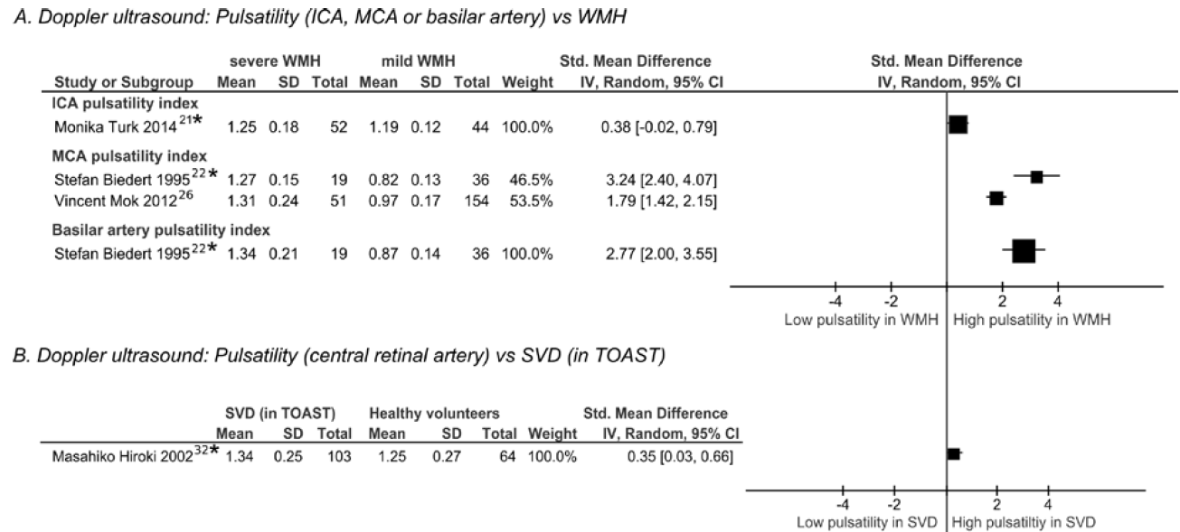
PI (ICA/MCA) and features of SVD
Shi et al. Clinical Science (2017)

Slide 12
Limitations
No follow-ups
Shi et al. Clinical Science (2017)
Shi et al. Clinical Science (2017)

Slide 13
Methods
Data from Austrian Stroke Prevention Study (ASPS)
  Community-based cohort study on the effects of vascular risk factors on brain structure and funtion in elderly participants
  (1991-2004)
ASPS Study design
  Elderly inhabitants of Graz (Austria) without a history of stroke or dementia (participation rate: 32.4%)
  Baseline and follow-up investigations including demography, vascular risk factors, neurosonography, neuroimaging and cognitive testing

Slide 14
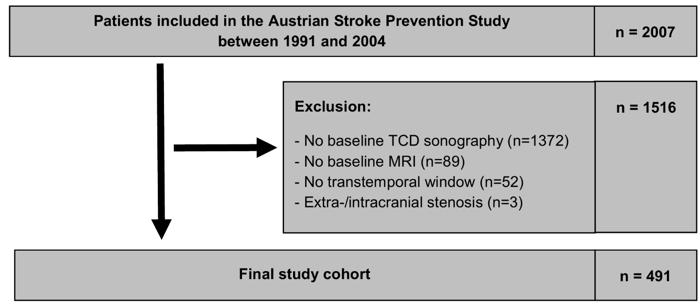
Methods

Slide 15
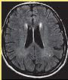
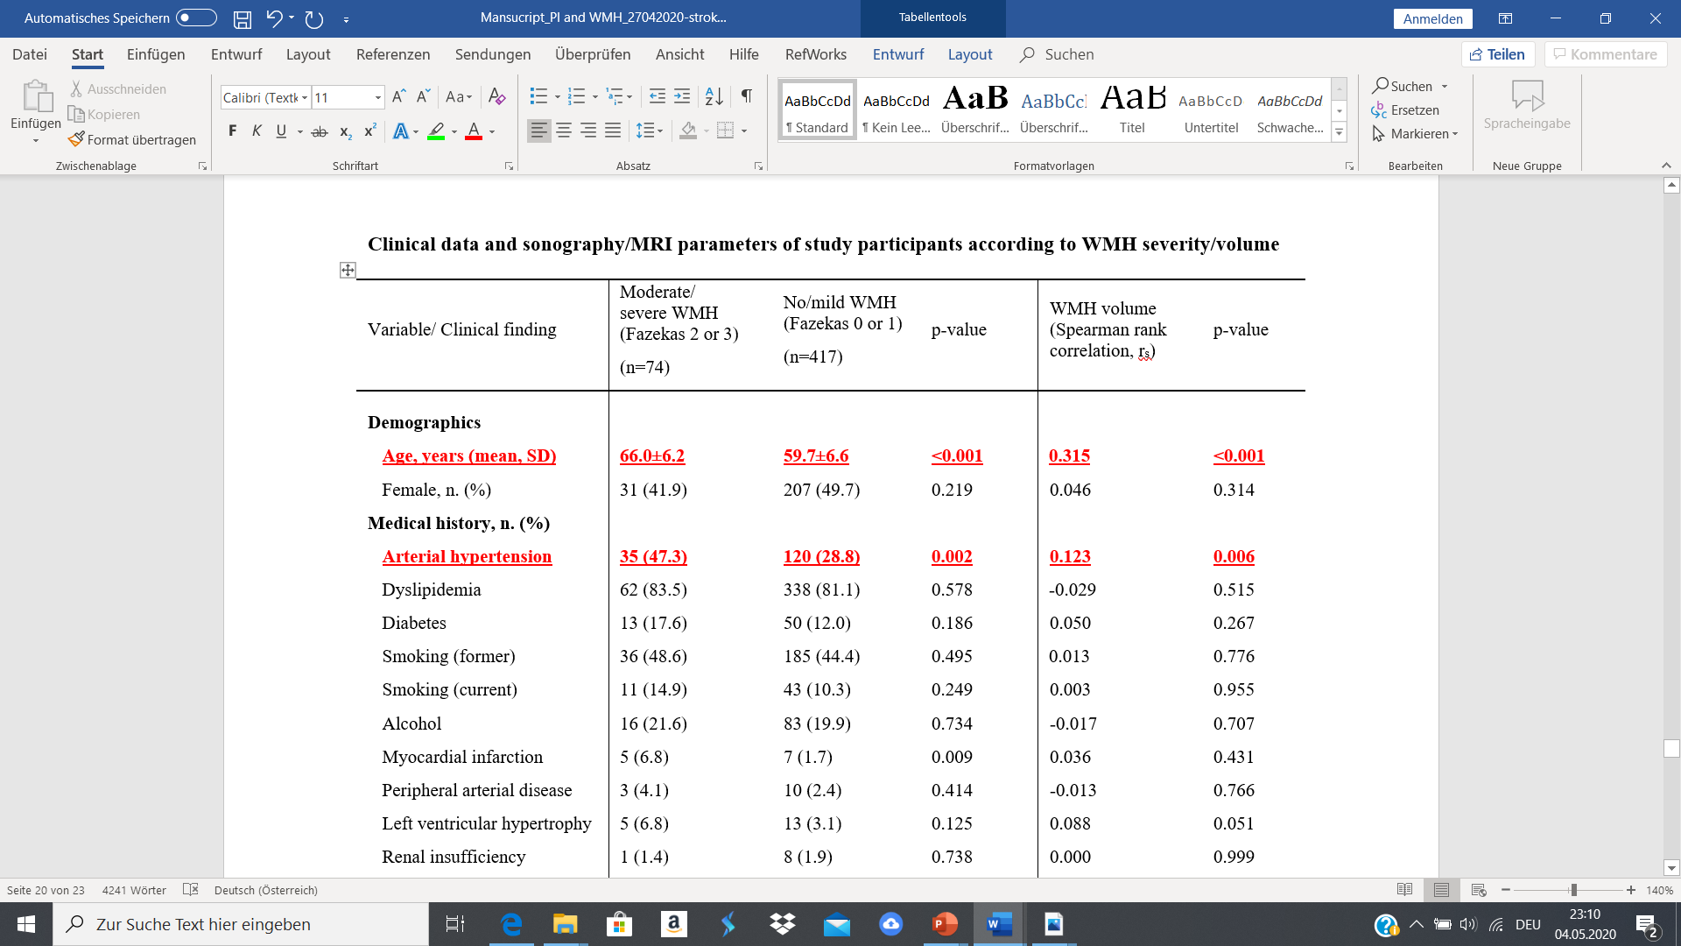
Results

Slide 16
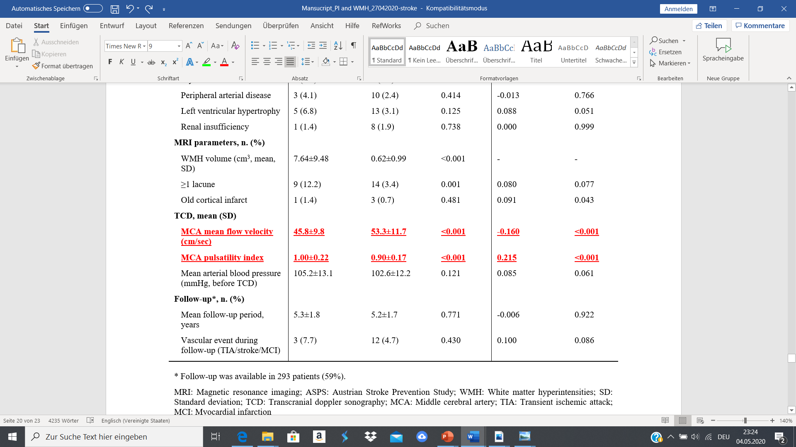
Results

Slide 17
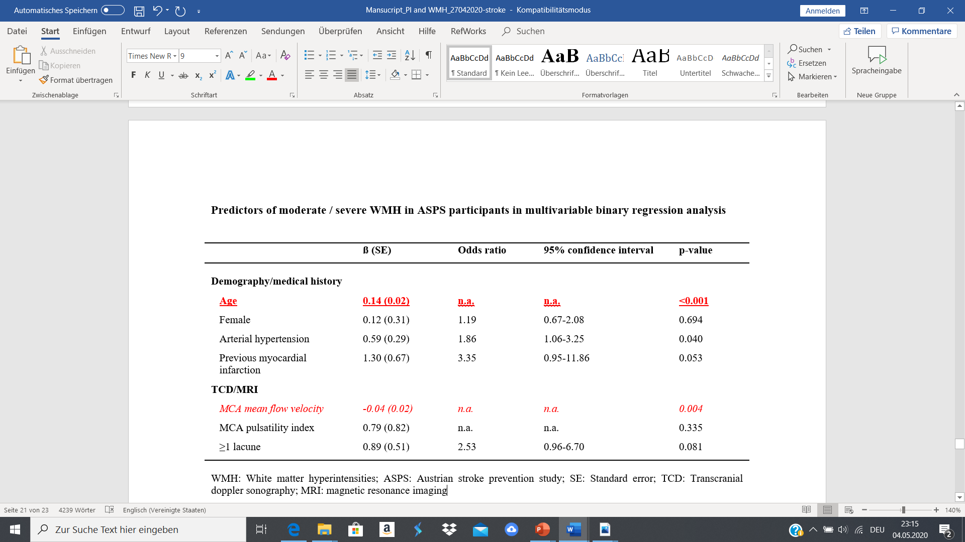
Results

Slide 18
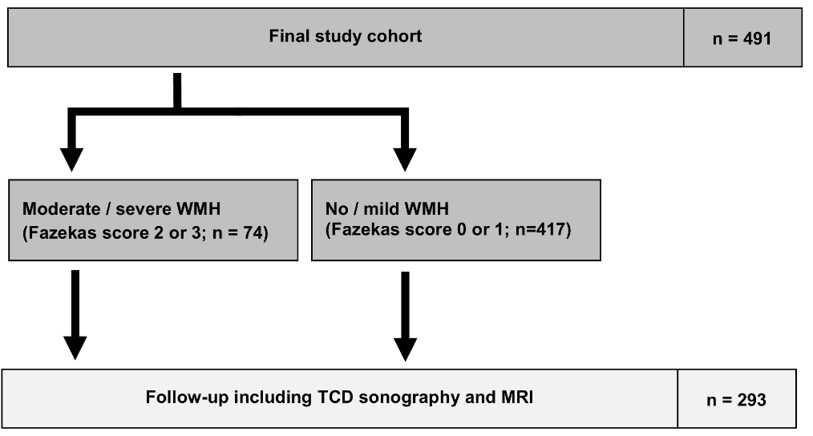
Results

Slide 19
Results
WMH progression: baseline – follow-up (mean: 5.3 years)

Slide 20
Results
WMH progression: baseline – follow-up (mean: 5.3 years)

Slide 21
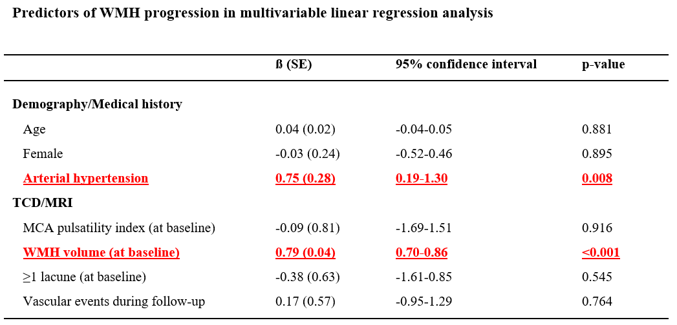
Results

Slide 22
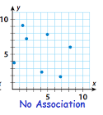
Discussion
Stroke- and dementia-free elderly subjects
  MCA pulsatility index is neither associated with microangiopathic WMH at
  Baseline
  Follow-up
  nor predictive of
  - WMH progression during follow-up

Slide 23
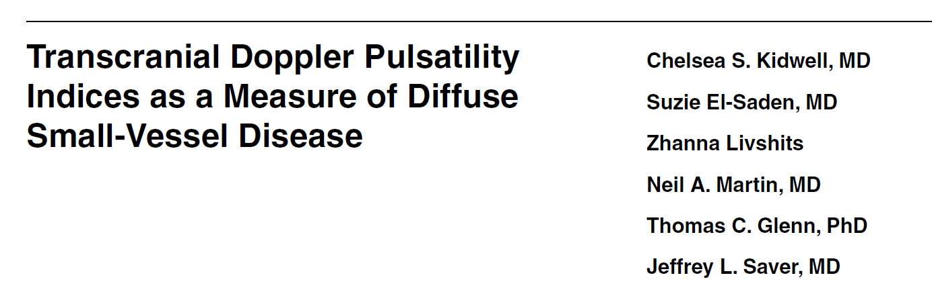

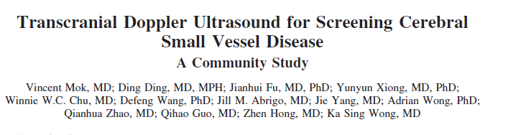

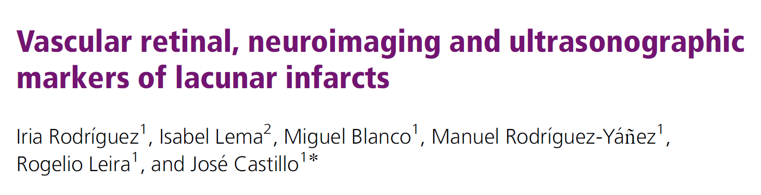
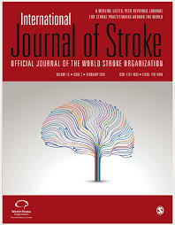
Discussion
Earlier studies
  Strong correlation between PI and WMH
  -small study cohorts
  -did not adjust for important confounders!
Kidwell et al. J Neuroimaging 2001
Mok et al. Stroke 2012
Rodriguez et al. Int J Stroke 2010

Slide 24
Discussion
Univariable analysis
Multivariable analysis
Adjusted for age and arterial hypertension!

Slide 25
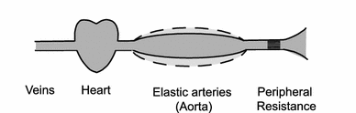
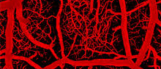
Discussion
Progression of white matter hyperintensities
  Hypothesis
Reduced Windkessel effect
Arterial stiffening
Damage of the
small cerebral vessels
Vulnerable cerebral capillaries
Pulsatile blood flow
Westerhof et al, Med Biol Eng Comput 2009

Slide 26
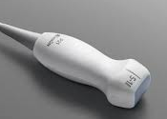
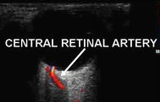
Discussion
1st longitudinal study that investigated TCD PI and WMH
  NO association between baseline PI and WMH progression over a 5-year follow-up
  Arterial hypertension was the only modifiable risk factor that remained predictive
Notes:
PI is only an indirect sign of vessel narrowing in downstream vascular beds and the effect might be too small to be detected sufficiently on TCD

Slide 27
Discussion
Limitations
  rather small overall WMH volumes (mean: 1.7 cm³)
  low number of study participants with lacunes / microbleeds
Summary
  In stroke and dementia-free elderly subjects PI …
  was neither associated with microangiopathic WMH at baseline
  Nor predictice of WMH progression during a 5-year follow-up
Notes:
Volunteers might not fully reflect the standard elderly population, as they might be more health-conscious and probably present a lower rate and better control of vascular risk factors.

Slide 28
Acknowledgements
Thomas Gattringer (MD, PhD)
Reinhold Schmidt (MD)
Christian Enzinger (MD)
Edith Hofer (PhD)
Kurt Niederkorn (MD)
Birgit Poltrum (MD)
Susanna Horner (MD)
Daniela Pinter (PhD)
Simon Fandler-Höfler (MD)
Sebastian Eppinger (MD)
Melanie Haidegger (MD)

